Slide 1
Flight Planning

Slide 2

Session Aims
Learn about …
Flight profile
Ascent Rate
Burst Altitude
How the above relate to each other, to gas volume, payload weight and balloon size
Descent Rate
Wind speed and direction changes
Good and bad predictions
Accuracy of predictions
Ground winds

Slide 3
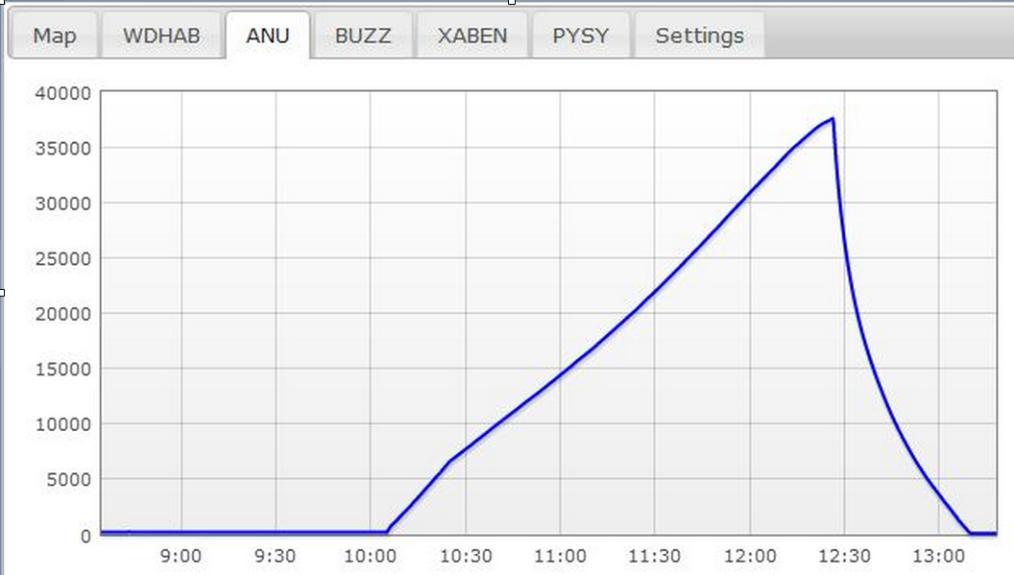
Typical Flight Profile

Slide 4
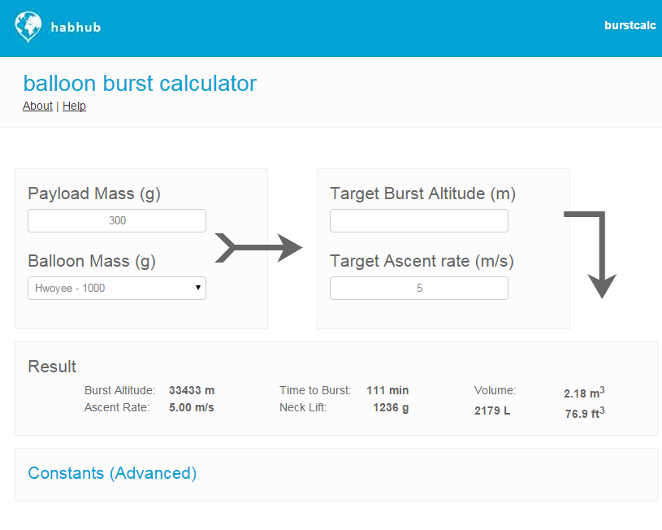

Slide 5
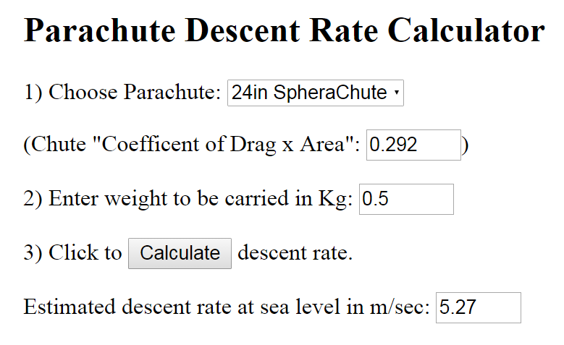
Descent

Slide 6
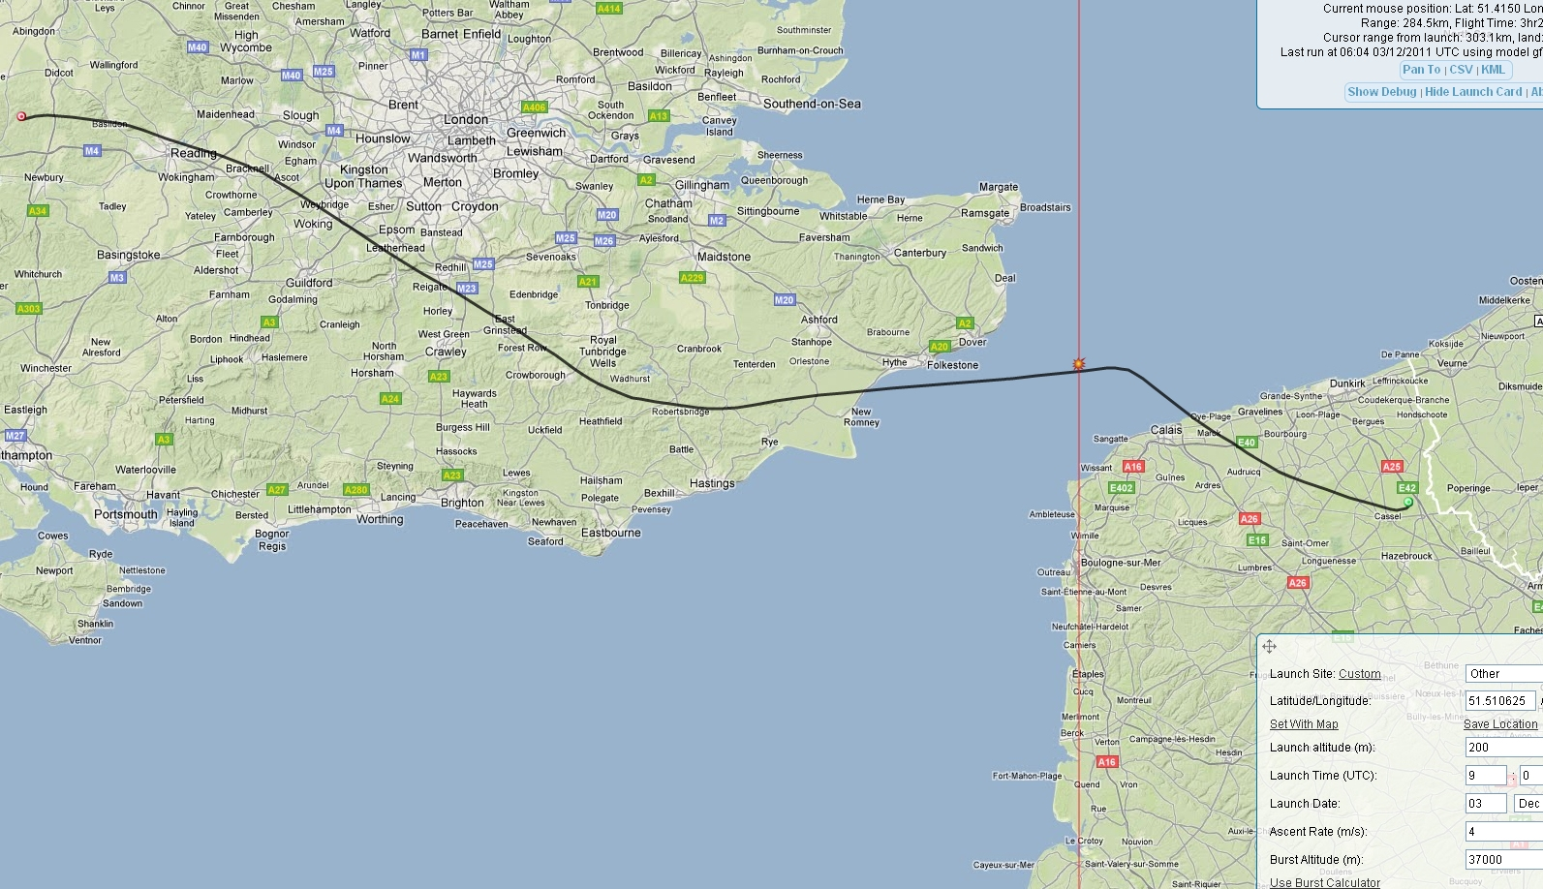
Typical Winter Flight Profile

Slide 7
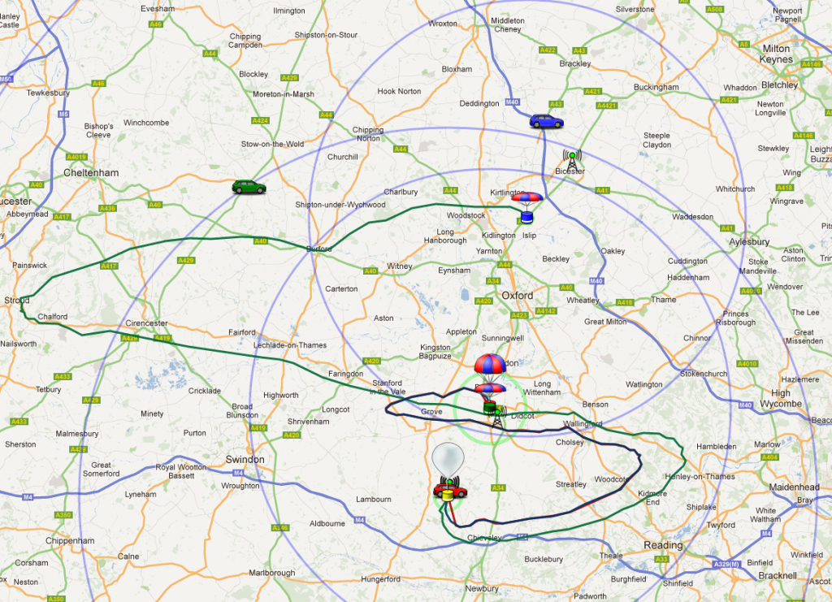
Typical Summer Flight Profile

Slide 8
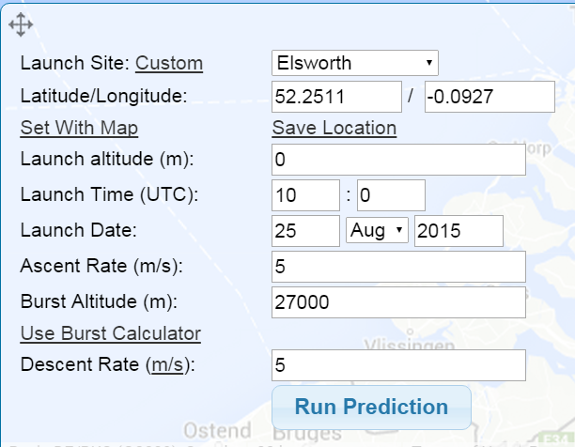
CUSF Flight Predictor

Slide 9
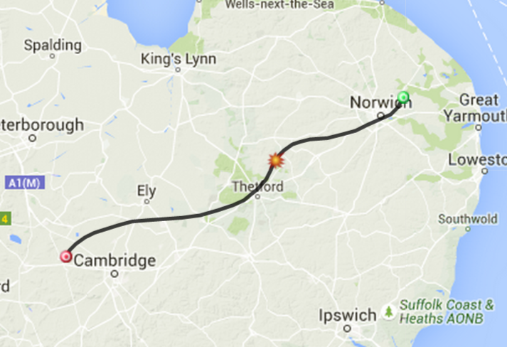
Flight Path for Tomorrow

